Slide 1
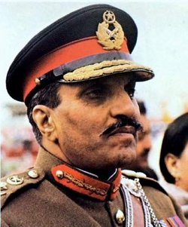
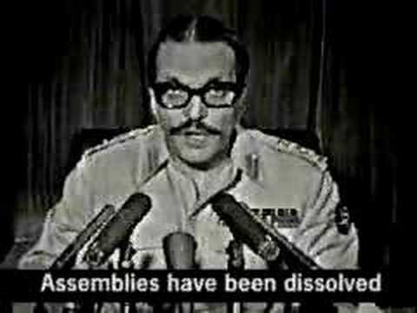
BUSHRA

Slide 2
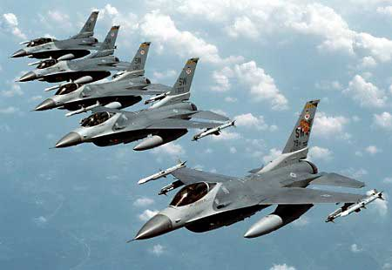
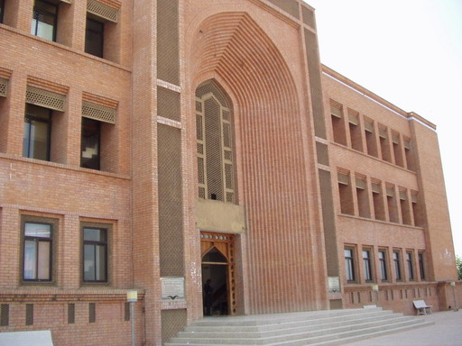
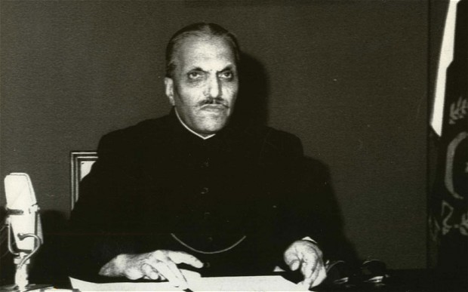
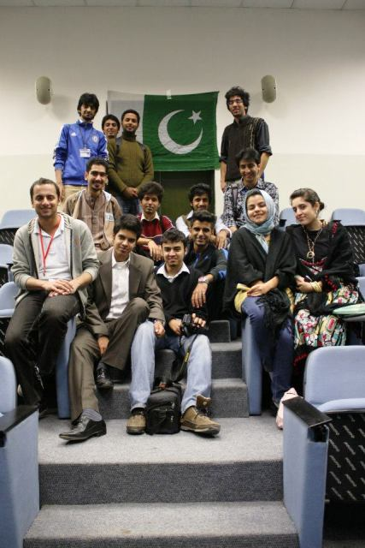
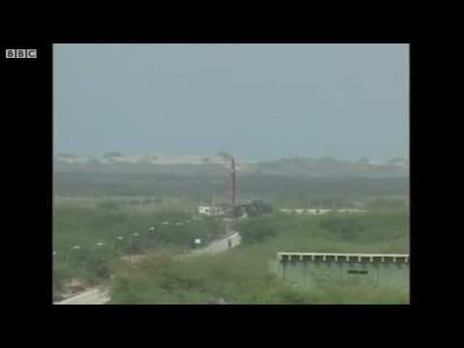
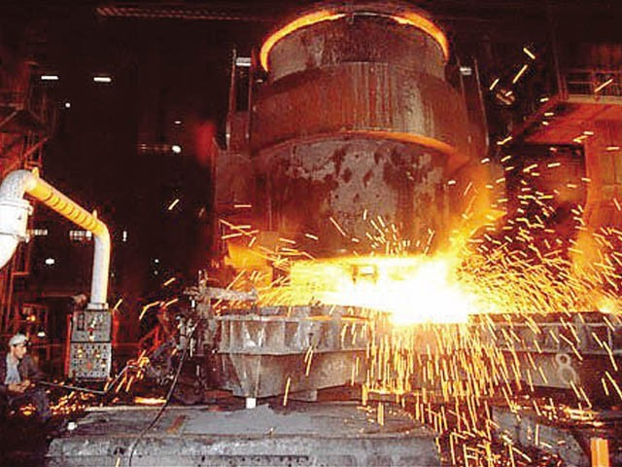
ERA OF GENERAL ZIA-UL-HAQ
1977-1988

Slide 3
Zia Coup, the Military Mechanism
The sheer opportunism, recklessness of most opposition politicians, and PNA movement against Bhutto played a vital role in calling for military intervention and facilitate the eventual take over by Zia.
ISI had active role in supporting PNA movement.
Martial Law was declared, government dismissed and assemblies were dissolved.
‘Operation Fair play’ was a planed and gradually implemented.
Zia was recommended by ISI to be made COAS.
Zia promised to conduct Fair and Free election within 90 days.

Slide 4
Zia and military had no intentions of leaving.
The lack of political mandate to rule, Zia decided to consolidate his power based beyond challenged by making the military itself his political constituency.

Slide 5
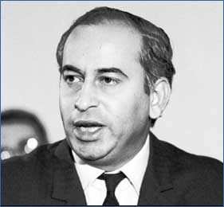
He needed to destroy the powerful charisma of Bhutto.

Slide 6
First, By destroying the charisma of Bhutto it could made them (military and Zia) to established their own credential to rule.
Second, for the time being this was an excuse for postponing the election.
Third, the objective was to eliminate Mr. Bhutto by the death penalty.
He construct allies with new ruling coalition.(JI, Feudal, Mushaikhs, judges,).Pir Sibghat Ullah in Sind, Ch zahoor Elahi in Punjab, khan Abdul Wali khan in NWFP.

Slide 7
The features of Zia's regime
He identify itself with America as compare with the Bhutto’ era who developed close ties with china and Russia. Soviet occupation of Afghanistan in 1979 provided him the opportunity to strength his bonds with USA and pursued a hostile policy towards Russia.
He demonstrated enthusiasm for capitalist methods economic development. He denationalized some industries nationalized by Bhutto.
Special importance to two Muslim countries Saudi Arab and Jordan.
He devised “Islamization Project “ for the political purpose of building supportive constituency by appeasing mullahs more than commitment to Islam

Slide 8
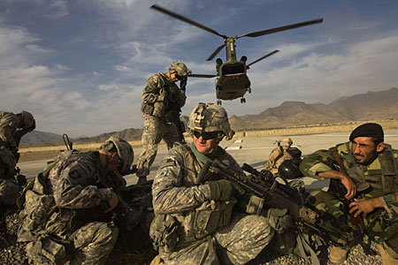
Afghan war-1979
Around 120,000 Russian troops entered Afghanistan
Zia stood against spread of communism and demanded expulsion of Russian forces from Afghanistan.
U.S supplied Afghanistan with surface-to-air Stinger missiles.
Pakistan continued to suffer from problems such as refugees, drugs, terrorism etc after the Afghan war.

Slide 9
Selective co-option Ilham with the task of creating an Islamic society
He declared that he had experienced the ilham and Allah almighty had communicated with him and charged him the task of creating an Islamic society and an Islamic economy in Pakistan.
Zia hoped that the project of “Islamization” would center legitimacy on his regime.
To justify his claim and exploitation of Islam for his political purpose a campaign was started on media that the idea of creating an Islamic state was indeed the ‘raison d'êtres’ of Pakistan. The islamization project did not work, the basic difficulty being that Zia was presiding over a peripheral capitalist economy

Slide 10
Referendum 1984
A referendum on the Islamisation policy of Zia-ul-Haq was held in Pakistan on 19 December 1984.
Voters were asked” whether they supported Zia-ul-Haq's proposals for amending several laws in accordance with the Quran and Sunnah, whether they wanted this process to continue, and whether they supported the Islamic ideology of Pakistan”.
The referendum also served as way of extending Zia-ul-Haq's presidential term by five years.
Official results declared it approved by 98.5% of voters, with a turnout of 62.2%. Independent observers questioned whether voter participation had reached 30% and noted that there had been "widespread irregularities".

Slide 11
Coalescing Islamic Traditional Through Religious Reforms
He activated IIC the Islamic ideology council to appease JI.
He introduced Islamic punishments of (amputation of wrists and ankles for theft, stoning to death for adultery and lashes for criminals and the law of evidence that of two women).
Abolishing interests in the banks lending by complicated system of transactions.(PLS Accounts).
The sharia faculty was created at Quaid-e-Azam university.
Zakat and Usher ordinance, recognition to religious degrees.
Nizam-e-Salat.

Slide 12
collateralization
He involved 3000 military officers in civilian administration and giving them all opportunities of profit and corruption .
This gave Zia an unshakable powers.
He inducted 400 military men into administration, industrial sector, and other economic institutions like (WAPDA,PASSCO,NLC).
He appointed core commanders as zonal chief martial law administrators.
Army officers would fill 10% of the vacancies of 17 and 18 grade of civil services.
The judiciary was collateralized through provisional constitutional order PCO in march 1981. The PCO terminated powers of the judiciary to question, scrutinize or to give any judgment on important executive actions. It required judges to take new oath of office to uphold the PCO.

Slide 13
Containment
The regime applied containment policy to PPP in particular and to the students, lawyers, and women in general.
To allow some political activity local bodies election were held in sep 1979.
Elections were held on non party in Jan 1985, with political parties banned and their activists in prison.
The labor and students unions were banned .
To project an inferior status to the women, Hudood Ordinance was promulgated in 1984.

Slide 14
REVIVAL OF 1973 CONSTITUTIONAL ORDER RCO
To empower the office of the president he issued an order of RCO in 1985 later adopted as Eighth Amendment in the constitution 1973.
The Eighth amendment made some changes and significant departure from the original premises and concepts in the constitution. The president was made all powerful, authorized to dissolve the assembly at discretion under amended article 58.2 (B). President Gen Zia was empowered to make appointment of Chiefs of Armed Forces and Chief Election Commissioner. President had authority to nominate a prime minister before obtaining the vote of confidence from national assembly and the governors were to be appointed by his discretion. The addition of article 270-A validated ordinance, laws, Acts, regulations, referendum and orders of martial law regime.

Slide 15
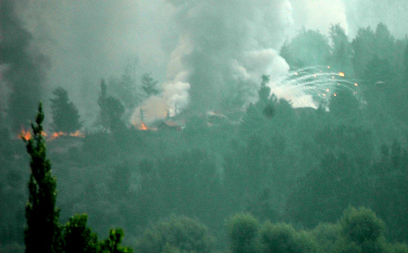
Incident of Ojheri camp-1988
Army ammunition was blown up
More than 100 people died
Defense department officials considered it as a work of agents of Afghan Intelligence service.
Recent politicians marked that as Zia ordered blowing up of missiles before arrival of US inspection team.

Slide 16
GENEVA ACCORD
Policy towards Afghanistan after the Geneva Accord was one of the contentious issue.
Zia and ISI were in total support of Islamic fundamentalists mujahedeen.
Prime minister Junejo was listing to other commands, from the US and a section of army that was closer to the US options and wanted the accord signed.
Zia dismissed Junejo and abolished the assembly.

Slide 17
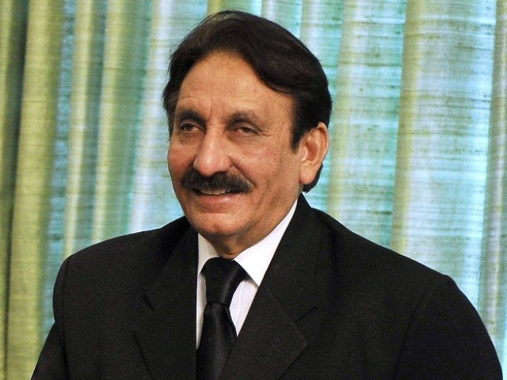
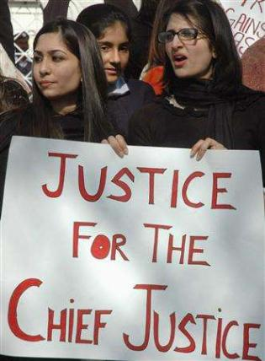
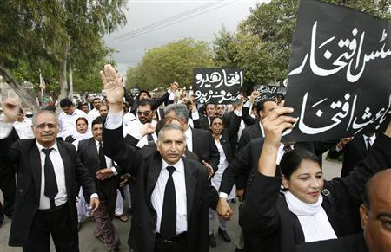
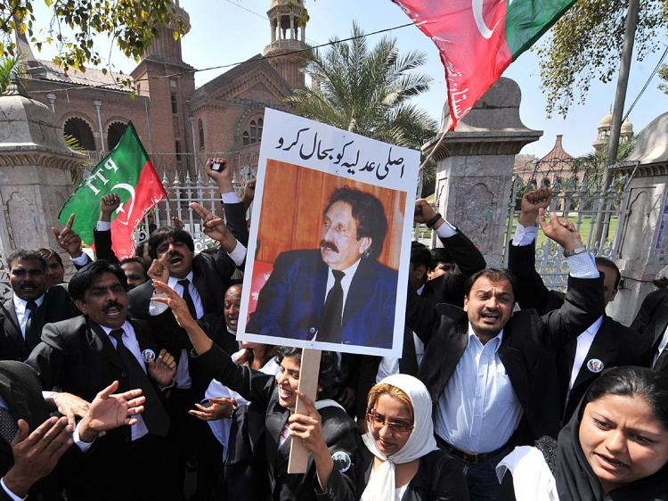
Suspension and reinstatement of the Chief Justice
On 9 March 2007, Musharraf suspended Chief Justice Iftikhar
Muhammad Chaudhry and pressed corruption charges
against him. On 12 March 2007, lawyers started a campaign
called Judicial Activism across Pakistan and began boycotting
all court procedures in protest against the suspension.
Slowly the expressions of support for the ousted Chief Justice gathered momentum and by May, protesters and opposition parties took out huge rallies against Musharraf and his tenure as army chief was also challenged in the courts

Slide 18
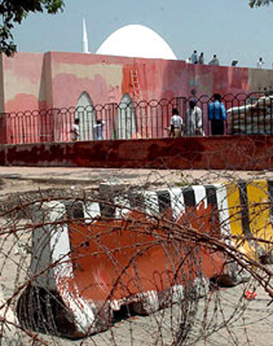
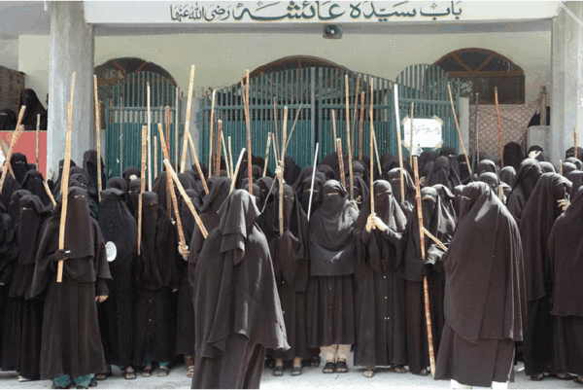
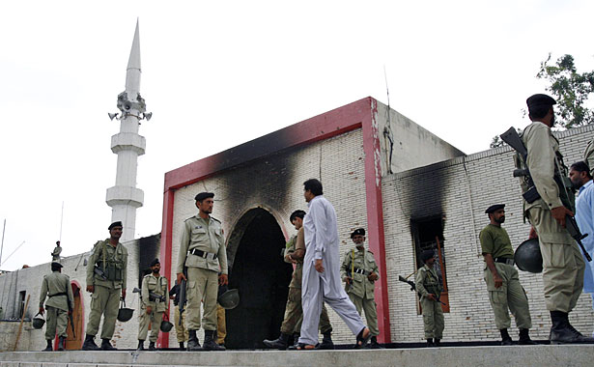
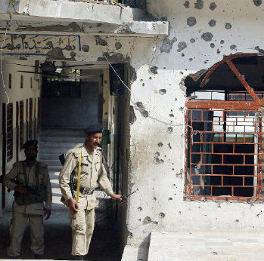
Lal Masjid siege
Lal Masjid had a religious school for women and the Jamia Hafsa madrassa, which was attached to the mosque. A male madrassa was only a few minutes drive away. In April 2007, the mosque administration set up its own Islamic court in violation of government sanctions.In July 2007, a confrontation occurred when government authorities sent officers for demolition of the mosque under the pretense that it was created illegally.

Slide 19
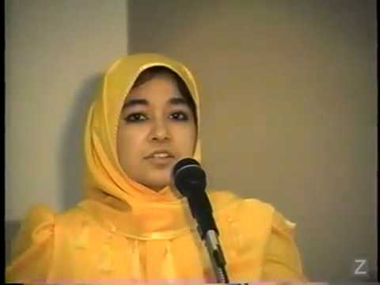
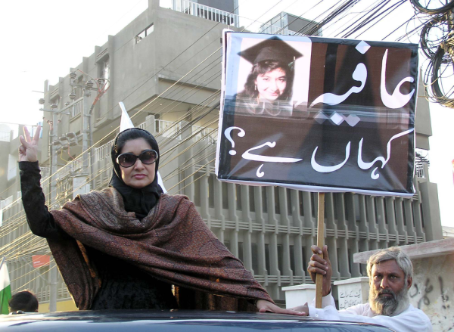
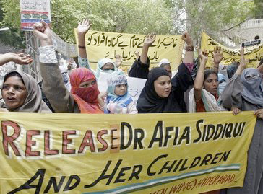
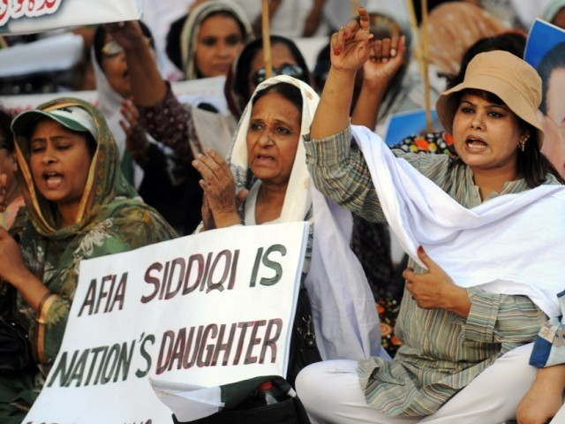
Dr Aafia Sidiqqie’s Conviction
The role of Pervez Musharraf in Aafia Siddiqui case is still a mystery because he was the one who allowed the FBI and other
US agencies to operate independently in Pakistan. He even admitted in his book “In The Line of Fire” that he handed over 369 people to the US and earned millions of dollars from the CIA but a former ISI official who worked with Musharraf very closely denied . She was presented as a gift to the US military in one of the most disgraceful acts ever committed by the head of an Islamic country or by the ruler of any country.

Slide 20
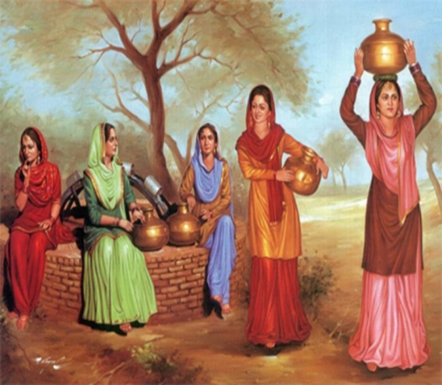
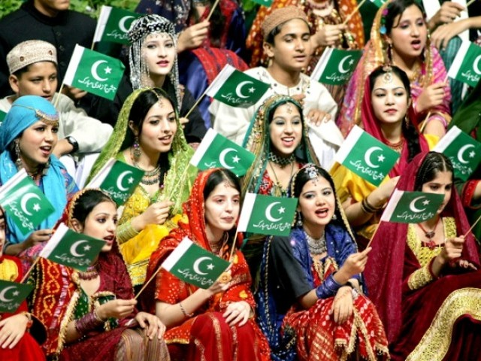

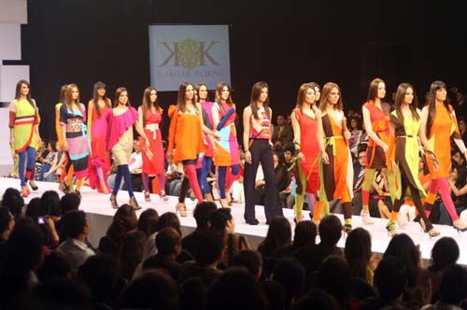
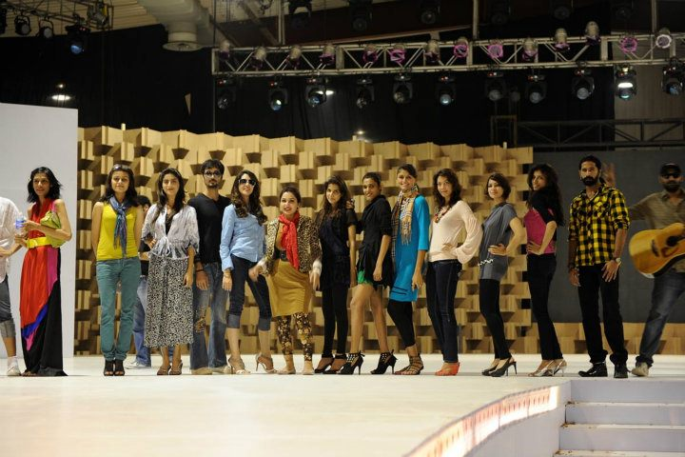
Westernization is Not Development
In Musharraf’s era Pakistani media was given freedom without any limits. Channels could show what ever they wanted.Thats where the problem begun. Our media presented western world in such a glittering way that anybody can become its victim. We don't even remember our own values and beliefs and therefore we are getting entrapped deeper into the web of westernization (so called advancement that is considered essential for development!)

Slide 21
CONCLUSION

